Slide 1
Introduction vision part II
Convolutional Neural Networks

Slide 2
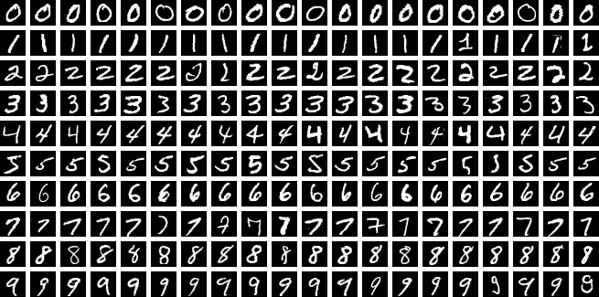
CNN – Hello world
Live demo:
https://adamharley.com/nn_vis/cnn/3d.html
https://en.wikipedia.org/wiki/MNIST_database

Slide 3
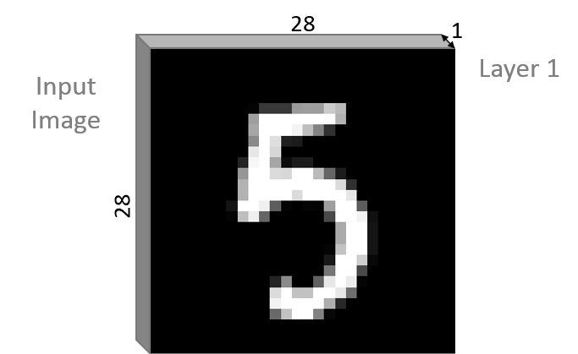
98.24 %

Slide 4
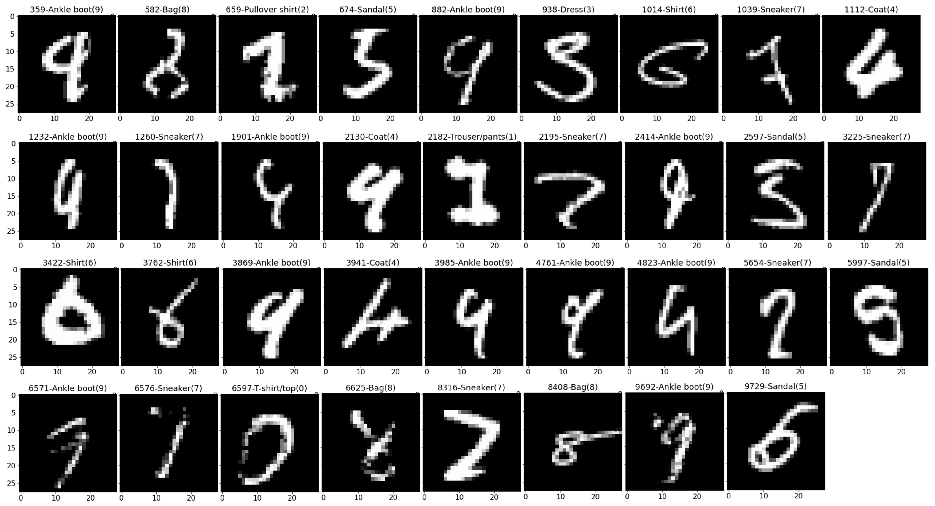
Easy?

Slide 5
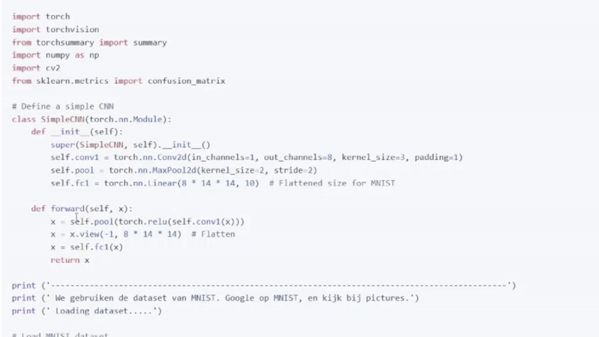
The code
Loss function
Training/validation/test sets
Activation function
Learning curve
Overfitting
Confusion matrix
Epoch

Slide 6
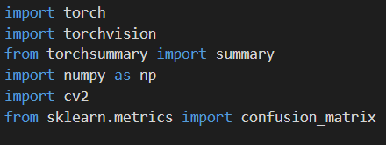
(Py)Torch
tensors
neural network architectures
Torchvision
datasets , loading
model architectures
image transformations
(torch)Summary function
- print a summary of a PyTorch model, including the layers, output shapes, and the number of parameters.

Slide 7
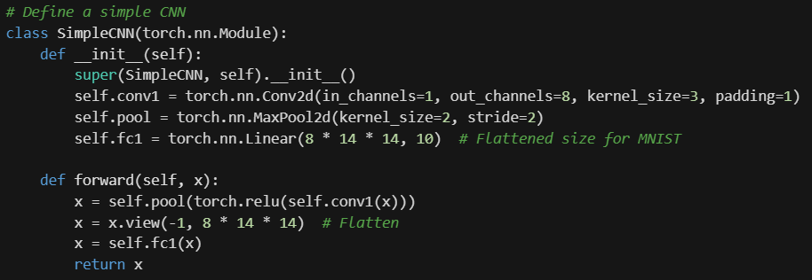

Slide 8
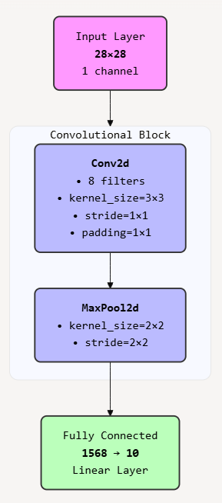

Slide 9
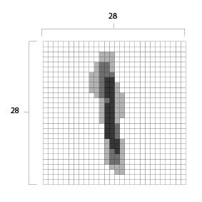
28x28

Slide 10
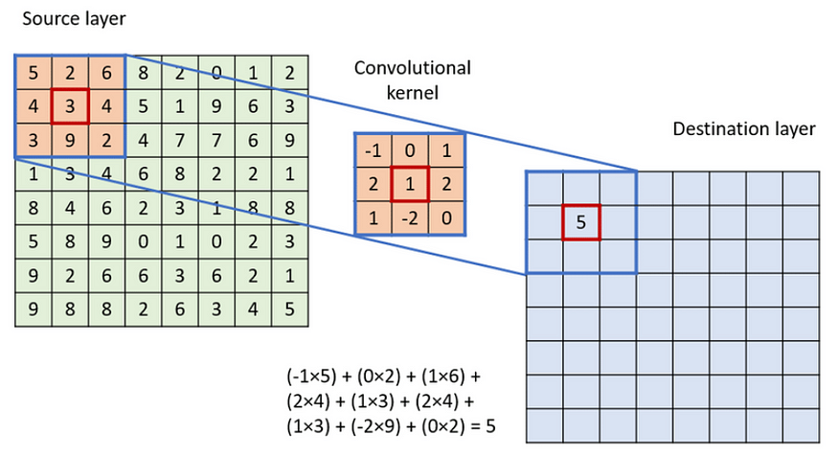
0 | 1 | 0
0 | 2 | 0
0 | 1 | 0
0 | 1 | 0
0 | 2 | 0
0 | 1 | 0
0 | 1 | 0
0 | 2 | 0
0 | 1 | 0
0 | 1 | 0
0 | 2 | 0
0 | 1 | 0
0 | 1 | 0
0 | 2 | 0
0 | 1 | 0
0 | 1 | 0
0 | 2 | 0
0 | 1 | 0
0 | 1 | 0
0 | 2 | 0
0 | 1 | 0
0 | 1 | 0
0 | 2 | 0
0 | 1 | 0
28x28
8x28x28

Slide 11
0 | 1 | 0
0 | 2 | 0
0 | 1 | 0
0 | 1 | 0
0 | 2 | 0
0 | 1 | 0
0 | 1 | 0
0 | 2 | 0
0 | 1 | 0
0 | 1 | 0
0 | 2 | 0
0 | 1 | 0
0 | 1 | 0
0 | 2 | 0
0 | 1 | 0
0 | 1 | 0
0 | 2 | 0
0 | 1 | 0
0 | 1 | 0
0 | 2 | 0
0 | 1 | 0
0 | 1 | 0
0 | 2 | 0
0 | 1 | 0
28x28
8x28x28
8x14x14

Slide 12
0 | 1 | 0
0 | 2 | 0
0 | 1 | 0
0 | 1 | 0
0 | 2 | 0
0 | 1 | 0
0 | 1 | 0
0 | 2 | 0
0 | 1 | 0
0 | 1 | 0
0 | 2 | 0
0 | 1 | 0
0 | 1 | 0
0 | 2 | 0
0 | 1 | 0
0 | 1 | 0
0 | 2 | 0
0 | 1 | 0
0 | 1 | 0
0 | 2 | 0
0 | 1 | 0
0 | 1 | 0
0 | 2 | 0
0 | 1 | 0
28x28
8x28x28
8x14x14
1568

Slide 13
0 | 1 | 0
0 | 2 | 0
0 | 1 | 0
0 | 1 | 0
0 | 2 | 0
0 | 1 | 0
0 | 1 | 0
0 | 2 | 0
0 | 1 | 0
0 | 1 | 0
0 | 2 | 0
0 | 1 | 0
0 | 1 | 0
0 | 2 | 0
0 | 1 | 0
0 | 1 | 0
0 | 2 | 0
0 | 1 | 0
0 | 1 | 0
0 | 2 | 0
0 | 1 | 0
0 | 1 | 0
0 | 2 | 0
0 | 1 | 0
28x28
8x28x28
8x14x14
1568
10

Slide 14
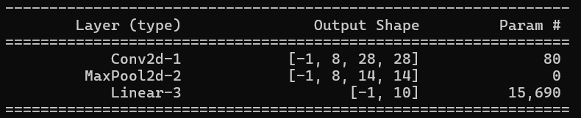
0 | 1 | 0
0 | 2 | 0
0 | 1 | 0
0 | 1 | 0
0 | 2 | 0
0 | 1 | 0
0 | 1 | 0
0 | 2 | 0
0 | 1 | 0
0 | 1 | 0
0 | 2 | 0
0 | 1 | 0
0 | 1 | 0
0 | 2 | 0
0 | 1 | 0
0 | 1 | 0
0 | 2 | 0
0 | 1 | 0
0 | 1 | 0
0 | 2 | 0
0 | 1 | 0
0 | 1 | 0
0 | 2 | 0
0 | 1 | 0
28x28
8x28x28
8x14x14
1568
10

Slide 15
0 | 1 | 0
0 | 2 | 0
0 | 1 | 0
0 | 1 | 0
0 | 2 | 0
0 | 1 | 0
0 | 1 | 0
0 | 2 | 0
0 | 1 | 0
0 | 1 | 0
0 | 2 | 0
0 | 1 | 0
0 | 1 | 0
0 | 2 | 0
0 | 1 | 0
0 | 1 | 0
0 | 2 | 0
0 | 1 | 0
0 | 1 | 0
0 | 2 | 0
0 | 1 | 0
0 | 1 | 0
0 | 2 | 0
0 | 1 | 0
28x28
8x28x28
8x14x14
1568
10

Slide 17
https://mistral.ai/
super(SimpleCNN, self).__init__()
constructor of the parent class nn.Module
self.conv1 = nn.Conv2d(in_channels=1, out_channels=8, kernel_size=3, padding=1)
Defines a 2D convolutional layer:
in_channels=1: The input image has 1 channel (e.g., grayscale).
out_channels=8: The layer produces 8 feature maps.
kernel_size=3: The size of the convolutional kernel is 3x3.
padding=1: Padding of 1 is added to the input to preserve spatial dimensions.
self.pool = nn.MaxPool2d(kernel_size=2, stride=2)
Defines a max pooling layer:
kernel_size=2: The size of the pooling window is 2x2.
stride=2: The window moves 2 pixels at a time, effectively downsampling the input by half.
self.fc1 = nn.Linear(8 * 14 * 14, 10)
Defines a fully connected (linear) layer:
8 * 14 * 14: The input size is calculated assuming the input image is 28x28 (common for MNIST dataset), which after convolution and pooling becomes 14x14 with 8 channels.
10: The output size, typically corresponding to the number of classes for classification.

Slide 18
def forward(self, x):
This method defines the forward pass of the network, specifying how data flows through the layers.
x = self.pool(torch.relu(self.conv1(x)))
Applies the convolutional layer conv1 to the input x.
Applies the ReLU activation function to introduce non-linearity.
Applies the max pooling layer pool to downsample the feature maps.
x = x.view(-1, 8 * 14 * 14)
Flattens the tensor from shape (8, 14, 14) to (1568)
x = self.fc1(x)
Passes the flattened tensor through the fully connected layer fc1.
return x
Returns the output of the network, which can be used for classification.

Slide 19
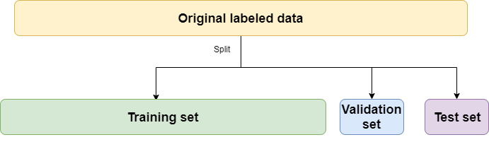
We ALWAYS* work with 3 data sets: train, validation, test
Train is to train the model
Validation is to optimize the model(s) (hyper tuning or model selection)
Test is to test the model ONCE, at the end, to determine final performance
Train 60~80%, Validation 10~20%, Test 10~20%

Slide 20
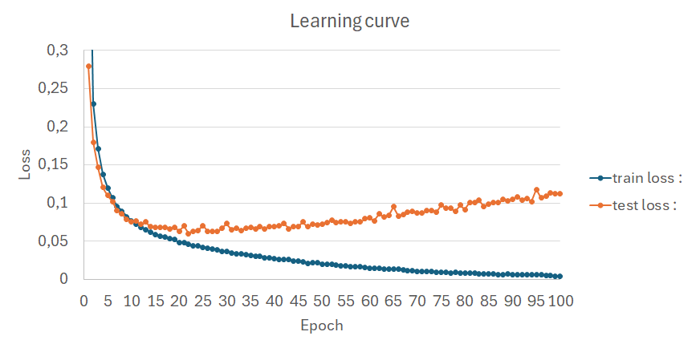
We ALWAYS* work with 3 data sets: train, validation, test
Train is to train the model
Validation is to optimize the model(s) (hyper tuning or model selection)
Test is to test the model ONCE, at the end, to determine final performance
Train 60~80%, Validation 10~20%, Test 10~20%

Slide 21
https://en.wikipedia.org/wiki/MNIST_database
https://github.com/zalandoresearch/fashion-mnist
https://archive.ics.uci.edu/
https://www.kaggle.com/datasets
https://image-net.org/index.php

Slide 22
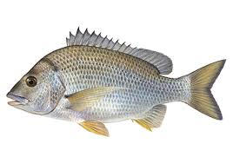
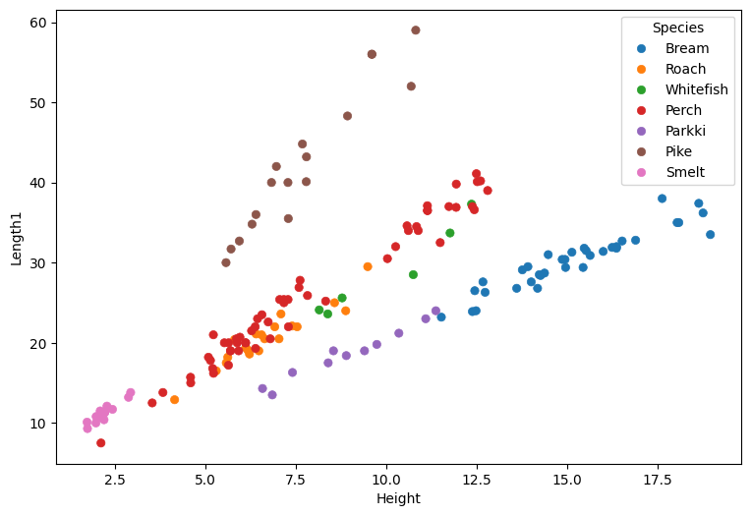
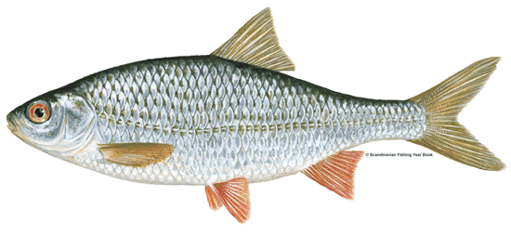
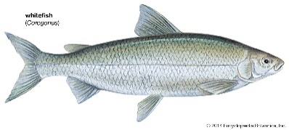
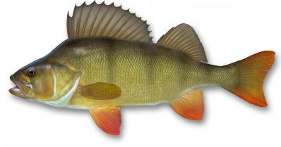

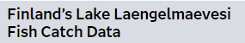
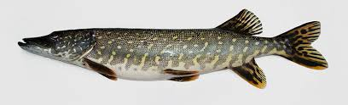
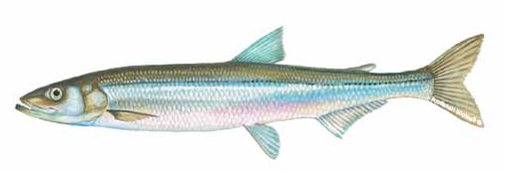
Classification
Parkki
https://documentation.sas.com/doc/en/statug/15.2/statug_sashelp_sect012.htm

Slide 23
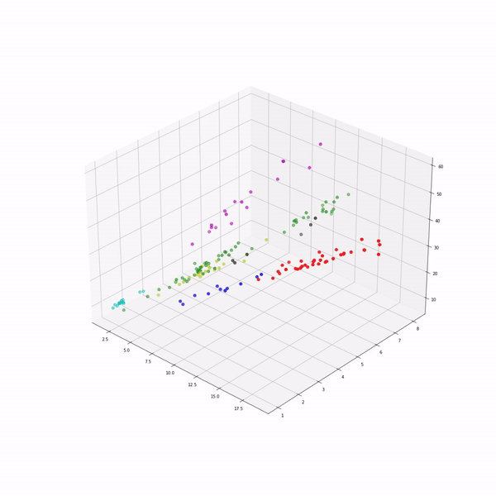
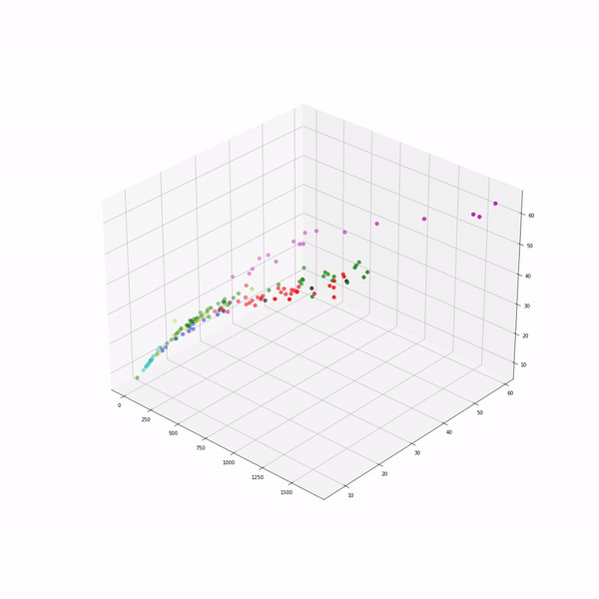
height-width-length
weight-length1-length2

Slide 25
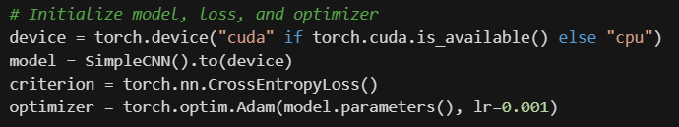
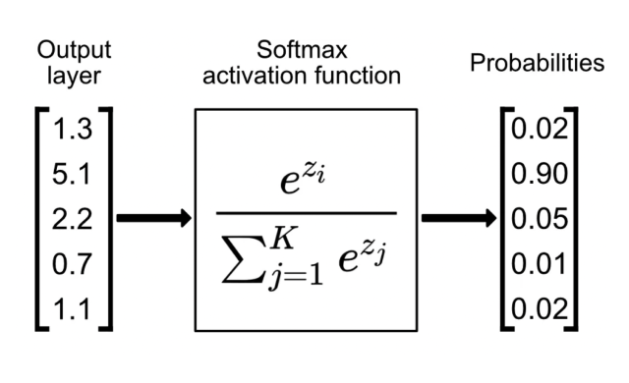
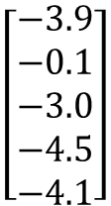
Instance van de klasse SimpleCNN, verbindt aan “device”
CrossEntropyLoss
Log softmax
CrossEntropyLoss
$$\left[\begin{aligned}−3.9 \\ −0.1 \\ −3.0 \\ −4.5 \\ −4.1\end{aligned}\right]$$
0.1
Adam optimizer:
https://youtu.be/CU7Hd6Z2c2Q?si=YwQhikZ8KIqw52OC
https://youtu.be/MD2fYip6QsQ?si=-29Tn5ZU53FNypoV

Slide 26
Results

Slide 27
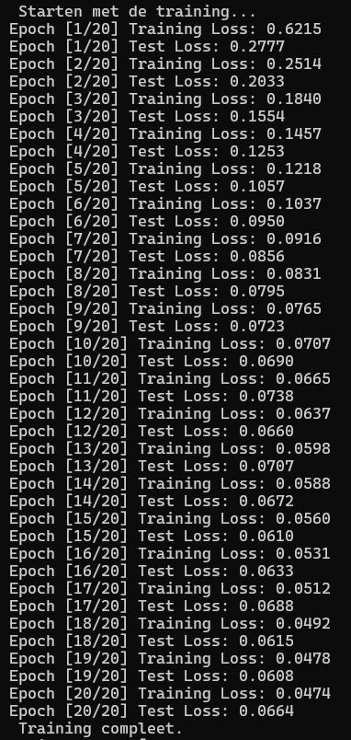
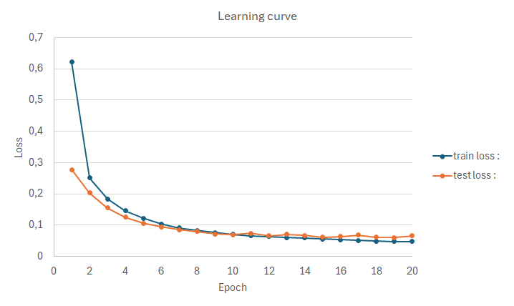

Slide 29
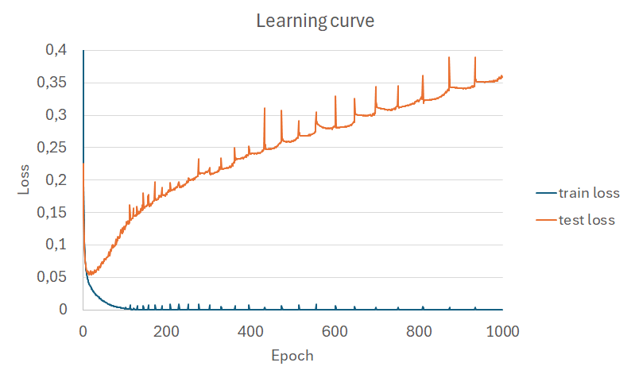

Slide 30
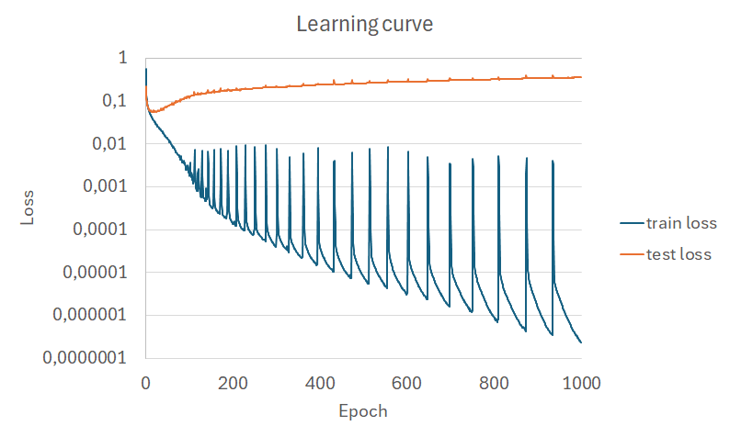

Slide 31
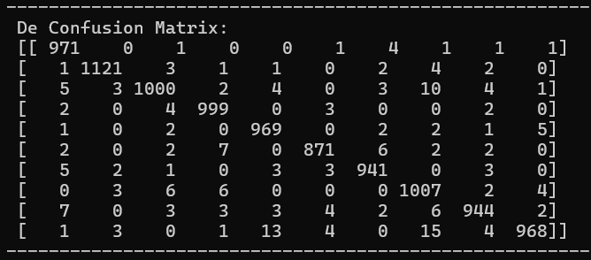
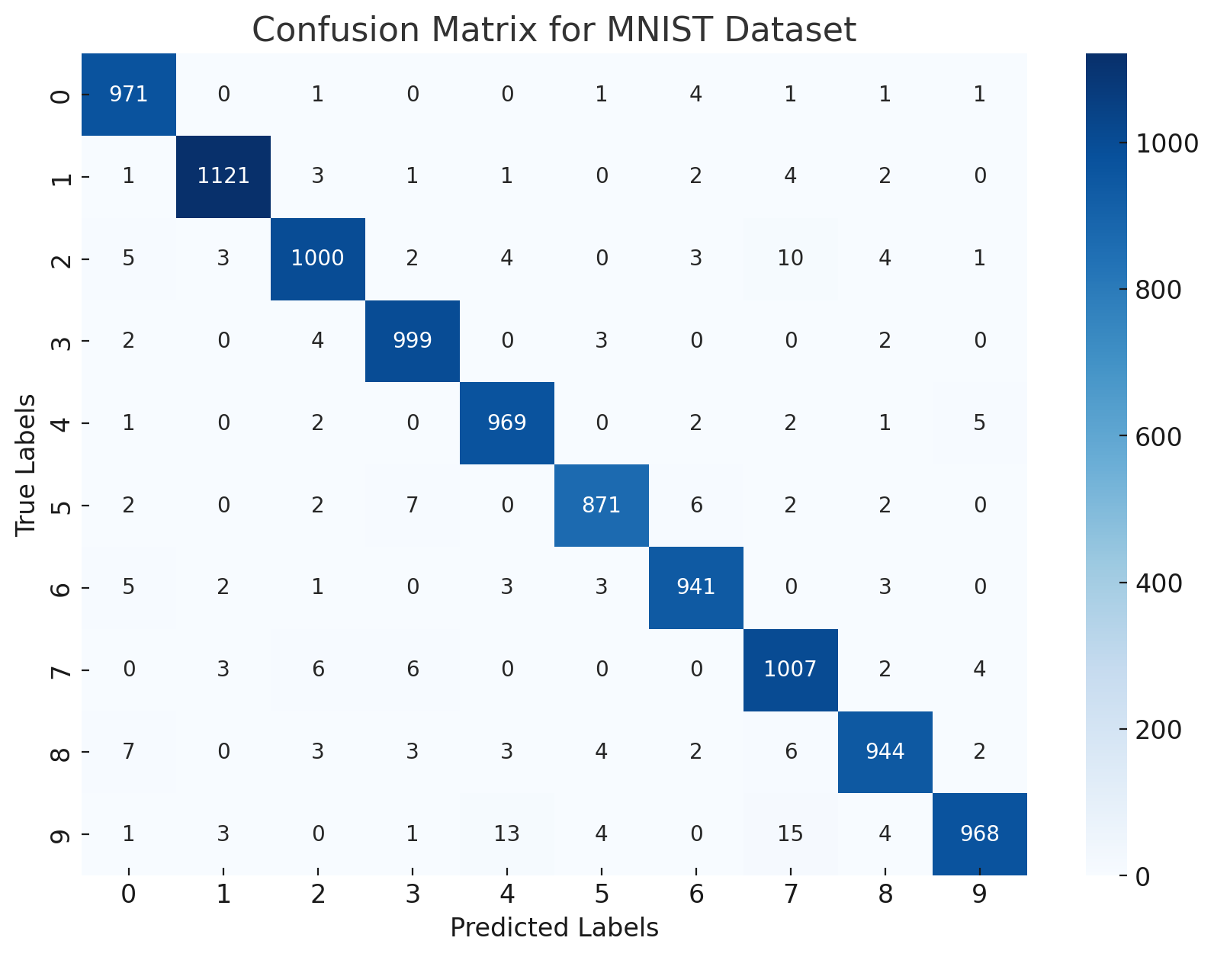

Slide 32





Slide 33

https://medium.com/@shrutijadon/survey-on-activation-functions-for-deep-learning-9689331ba092

Slide 34
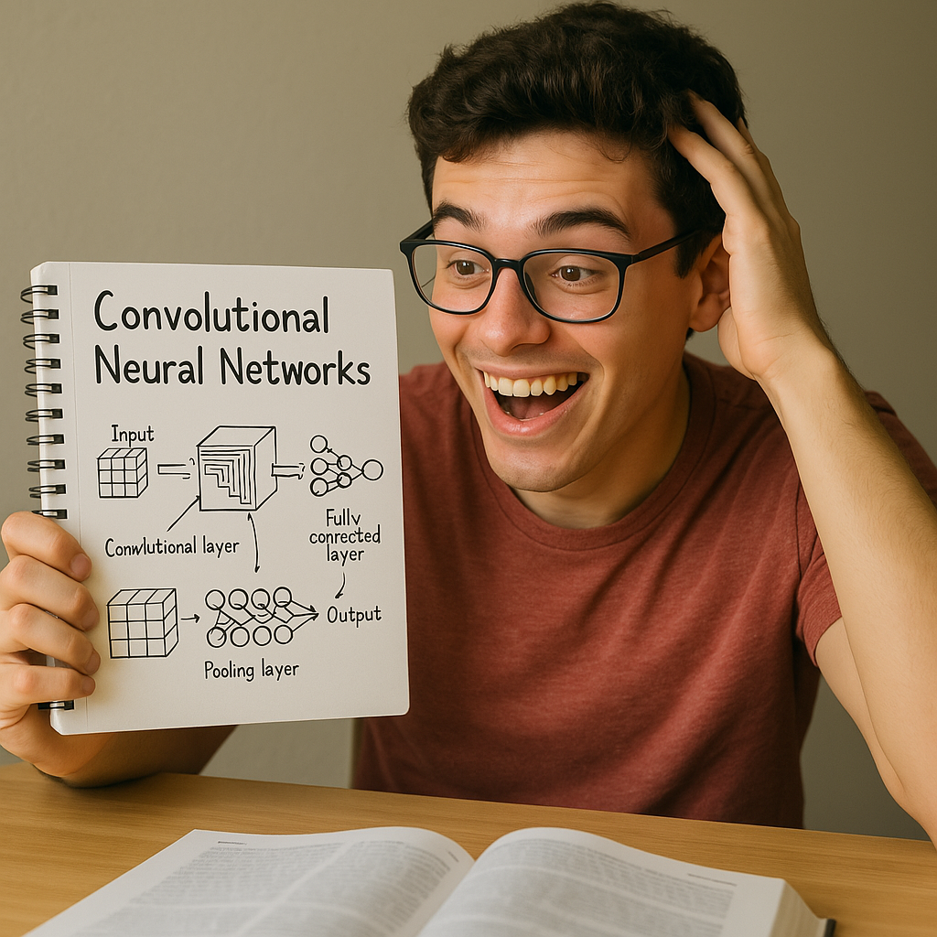
Thanks!

